Slide 1
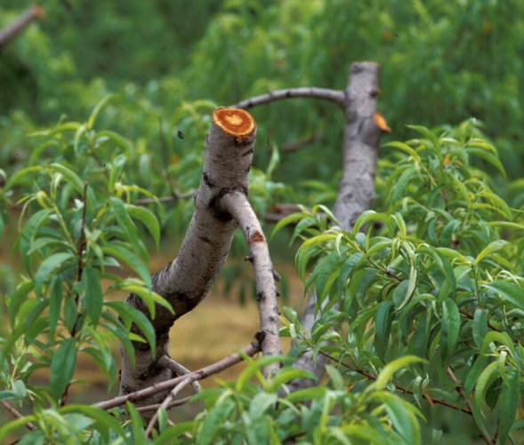
Winter Damage to Peaches – Management Implications
Bill Shane
Tree Fruit Extension Specialist Michigan State University SW Michigan Research and Extension Center Benton Harbor, Michigan
MSU is an affirmative-action, equal-opportunity employer. Michigan State University Extension programs and materials are open to all without regard to race, color, national origin, gender, gender identity, religion, age, height, weight, disability, political beliefs, sexual orientation, marital status, family status or veteran status.

Slide 2
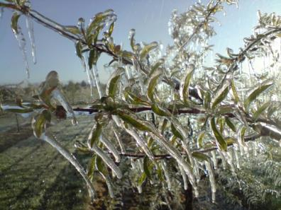
Purpose of talk
Increase your ability to assess cold damage in peach
Increase your ability to anticipate damage based on type of cold event and peach orchard situation
Help learn / reinforce strategies to reduce impact of future cold events

Slide 3
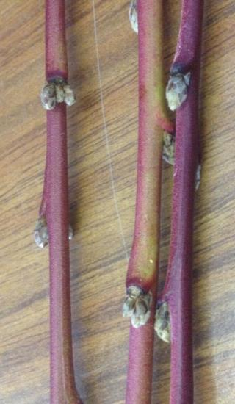
Fruit types differ in the mid-winter hardiness of their flower buds
Critical temp. (F) Fruit type for flower injury
Apple -30
Apricot, Pear, Concords -25
Blueberries -25
Tart Cherry -20
Raspberry -17
Blackberry -15
Plum, Sweet Cherry -15
Peach and Nectarine -13
European Grapes -8 to -15

Slide 4
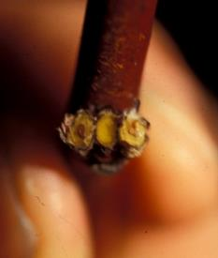
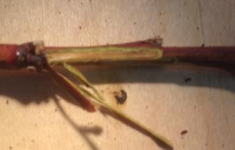
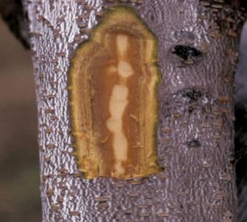
Three site / levels of cold damage to peach tree
1st Flower buds - Bud cross section shows brown tissue of dead fruit buds with healthy leaf bud in middle positions
2nd Twig damage – Brown cambial layer under bark
3rd Trunk damage - Brown cambial
layer under bark
Notes:
Symptoms of winter damage can be seen in the tender cambium layer under bark (peach), buds especially flower buds (peach), and shoot tips (blueberry)
Photos: Bill Shane

Slide 5
Mid winter temperatures and general effects on peaches
-11 F start of fruit bud damage
-13 F 50% fruit buds damaged
-15 F 80% fruit buds damaged, some cambium discoloration
-17 F most fruit buds damaged, some significant cambium discoloration
-19 F no fruit buds left, some tree mortality expected

Slide 6
Low temperature events in Michigan resulting in damage to peaches
Fall Oct 10, 1906 10 F Nov 24, 1950 -15 F Nov 17, 2013 Rapid drop | Mid winter Jan 25, 1961 -17 F Jan 15, 1972 -17 to -20 F Jan 16 & 19, 1994 -17 to -22 F Feb 3, 1996 -13 to -17 F Jan 5, 1999 -16 F Jan 2005 Rapid drop Feb 4-7, 2007 -4 to -14 F Jan 2014 -13 to -18 F Jan 2015 -9 to -23 F

Slide 7
Low temperature events in Michigan resulting in damage to peaches
Fall Oct 10, 1906 10 F Nov 24, 1950 -15 F Nov 17, 2013 Rapid drop | Mid winter Jan 25, 1961 -17 F Jan 15, 1972 -17 to -20 F Jan 16 & 19, 1994 -17 to -22 F Feb 3, 1996 -13 to -17 F Jan 5, 1999 -16 F Jan 2005 Rapid drop Feb 4-7, 2007 -4 to -14 F Jan 2014 -13 to -18 F Jan 2015 -9 to -23 F
= tree decline in addition to fruit bud loss

Slide 8
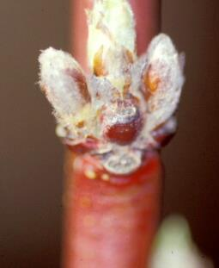
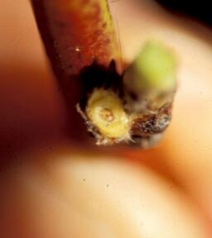
Level 1: Freeze damage to peach fruit buds
Cross-section cut on left fruit bud to see if it is damaged
Brown pistil in peach fruit bud

Slide 9
Relative fruit bud winter hardiness rating for peach and nectarine varieties following 2013/2014 winter, SW Michigan Research and Extension Center.
Fruit bud hardiness rating | Peach | Nectarine | PeenTo
Low (poor bud survival) | Crimson Rocket, Flavrburst, PF11 Peach, PF7A-Freestone, Sweet Breeze | Ambre, Emeraude*, Honey Blaze | Tangos I (NJF16), BuenOs I (NJF18)
Intermediate | Autumnstar, Beaumont, Canadian Harmony, Coralstar, Cresthaven, Desiree, Early Redhaven, Glenglo, Gloria, Harrow Diamond, Halehaven, Loring, Messina, PF24C-Cold Hardy, PF35-007, Redstar, Risingstar, PF19-007, Vinegold# | Easternglo, Fantasia Zephyr | Galaxy, Tangos II (NJF17)*
High (good fruit bud survival) | Allstar, Blushingstar*, Brightstar, Catherina#, Contender, Earlystar, Ernies Choice, Flameprince, Glowingstar, Madison, McKay, PF Early 8 Ball, PF-25, Redhaven, PF9A-007, PF8 Ball, PF23, PF27A, PF28-007, Richhaven, Starfire, Veteran, Victoria, Virgil# |  | Saturn*
* = white flesh, # = non-melting flesh canning type. Limb tip dieback ratings made June 17, 2014.

Slide 10
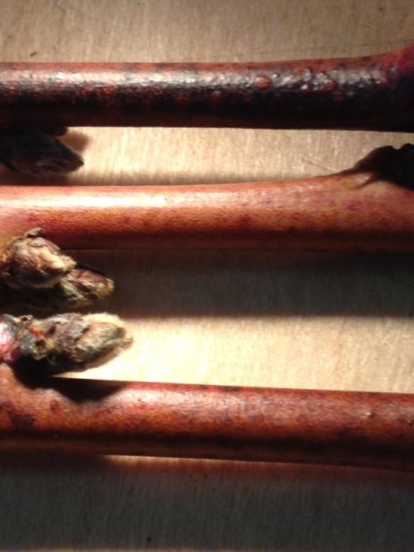
Level 2: Peach branch hardiness
Exposed to
@ -15 F
Exposed to
@ -13 F

Slide 11
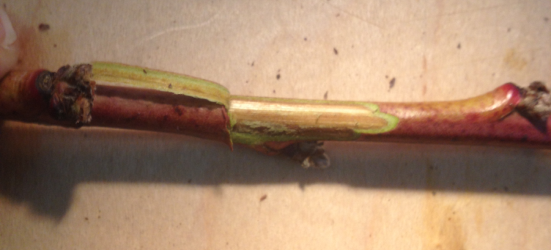
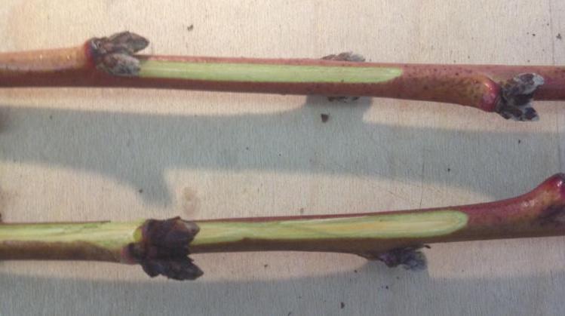
Peach cambium browning
Exposed to
@ -15 F
Exposed to
@ -13 F

Slide 12
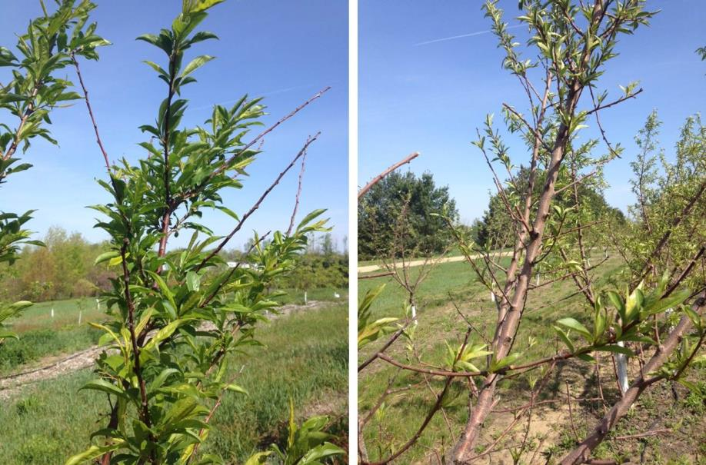
Peach branch terminal dieback

Slide 13
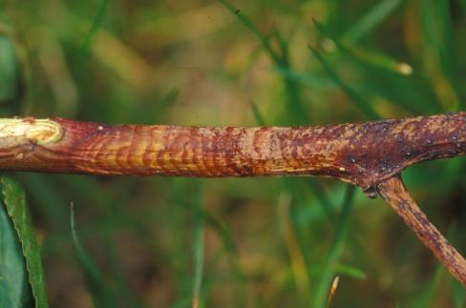
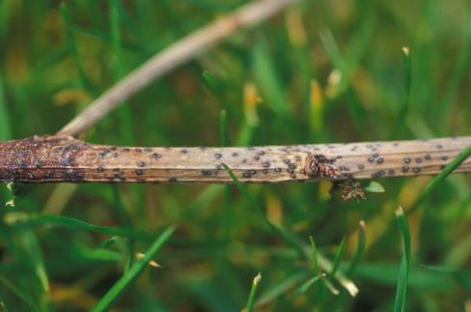
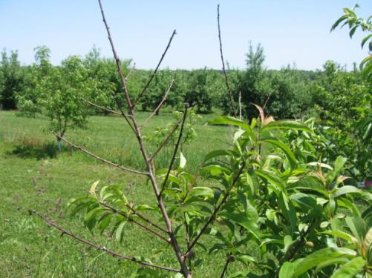
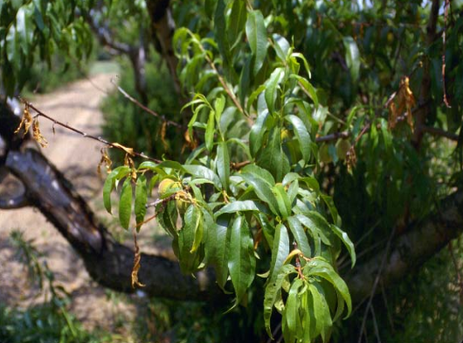
Constriction canker (Phomopsis) fungal disease sometimes worse following stressful winter on some varieties
Lower right picture: Rutgers, rest from Michigan

Slide 14
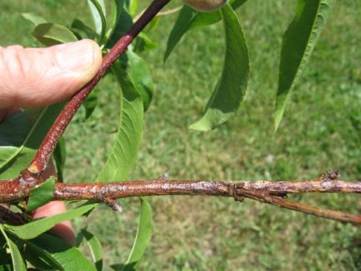
Constriction canker (Phomopsis) fungal disease sometimes worse following stressful winter on some varieties
A survey among South Carolina peach growers indicated that the following varieties are highly susceptible: Contender, Cresthaven, Empress, Springcest,
Redhaven, Red Globe and the Baby Gold series. In New Jersey, high levels of infection have been observed in Encore, Biscoe, Jerseyglo, Autumnglo, Cresthaven, and Redhaven.
Management: Pruning to remove affected wood may be sufficient. If severe, post harvest chlorothanil application may help to suppress disease

Slide 15
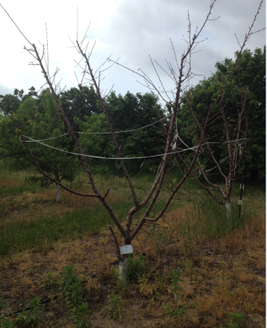
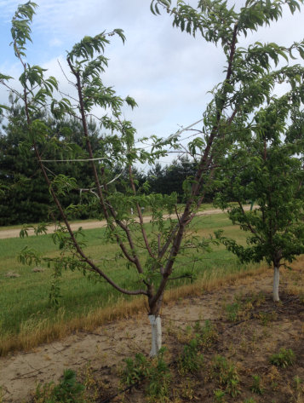
Branch tip dieback following 2013/2014 winter, SW Michigan Research and Extension Center.
BuenOs (NJF18) peen tao peach
Ambre nectarine

Slide 16
Branch tip dieback rating for peach and nectarine varieties following 2013/2014 winter, SW Michigan Research and Extension Center.
Limb dieback rating | Peach | Nectarine | PeenTo
Severe, tree dead or dying |  |  | BuenOs I (NJF18)
Tree will live, significant pruning required | Flavrburst, Crimson Rocket, Vinegold, |  | TangOs I (NJF16), Tangos II (NJF17)*, BuenOs II (NJF15)
Moderate pruning needed | Halehaven, Glowingstar, Gloria, Glenglo, Desiree, Ernies Choices, PF11 Peach
Modest dead wood pruning needed | Honey Blaze, Sweet Breeze, PF-7A Freestone
Few limb tips with dieback, damage relatively inconspicuous | Redhaven, PF Early 8 Ball, PF-23, PF-9A-007, Newhaven, Messina, Beaumont, PF-27A, Blushingstar*, Flameprince, PF-25, Catherina, Autumn Star, Victoria, Virgil, Redstar, Cresthaven, PF-28-007, Summerfest, Risingstar, PF-24C Cold Hardy | Easternglo, Emeraude*, Zephyr*, Ambre,
No damage | Brightstar, Coralstar, Allstar, Canadian Harmony, Early Redhaven, Glohaven, Madison, McKay, Contender, Harrow Diamond, PF-19-007, Earlystar, PF35-007, PF5D Big, Loring, Starfire, Veteran | Fantasia, PF11 Nectarine, Silver Gem* | Saturn*
BuenOs
Ambre
* = white flesh, # = non-melting flesh canning type. Limb tip dieback ratings made June 17, 2014.

Slide 17
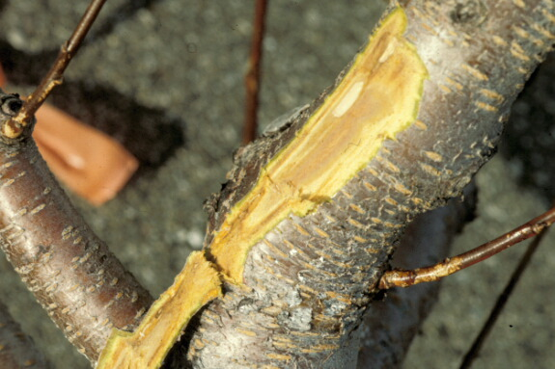
Level 3: Freeze damage to peach trunk & scaffold cambium
Brown cambium following -19 F low temperatures in 1994

Slide 18
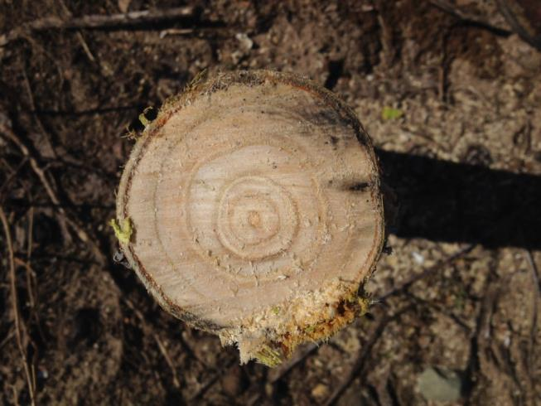
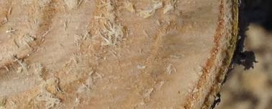
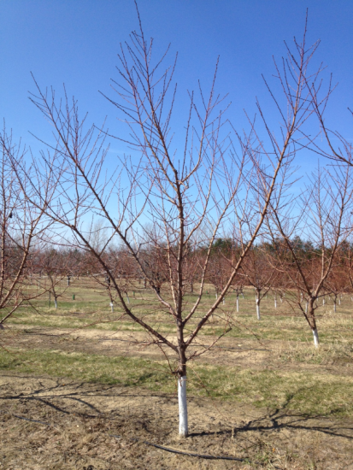
Peach peach trunk cross-section
Cambium
Xylem
Phloem
Sapwood
Bark
Sapwood – water conduction, active disease defense,

Slide 19
Low temperature damage to peach sapwood
Trees were exposed to -17 F or lower

Slide 20
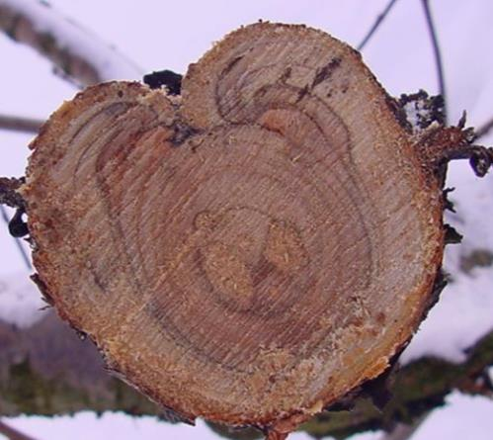
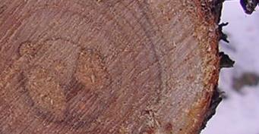
Older peach trunk cross-section
Cambium
Xylem
Phloem
Heartwood
Sapwood
Bark
Sapwood – outer rings of xylem, water conduction, active disease defense, protection of inner heartwood center.
Heartwood – 4+ years in age, support, little water movement, no disease suppression

Slide 21
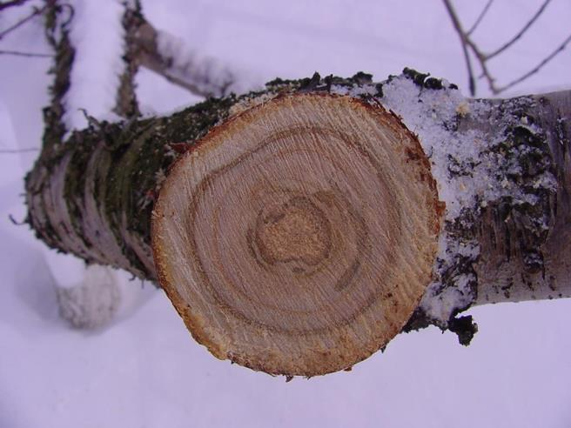
Peach peach trunk cross-section
Undamaged
Damaged but generally healed

Slide 22
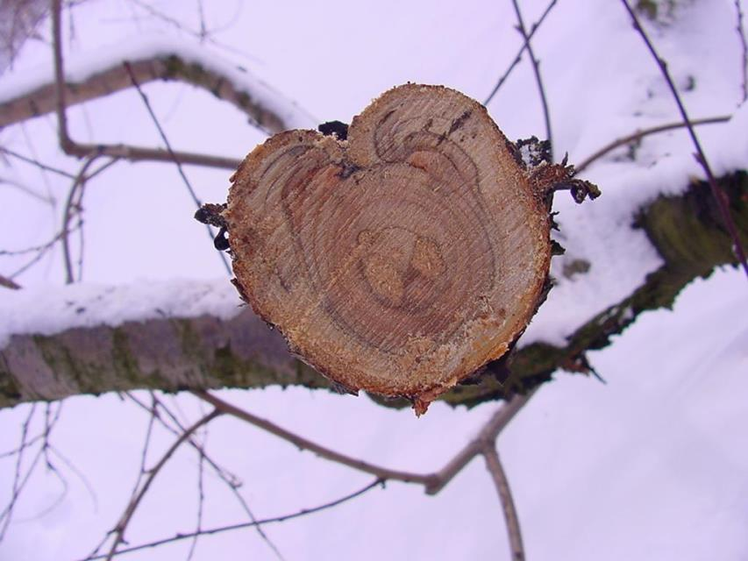
Peach trunk cross-section
Heartwood poorly protected by sapwood layer

Slide 23
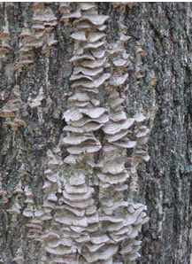
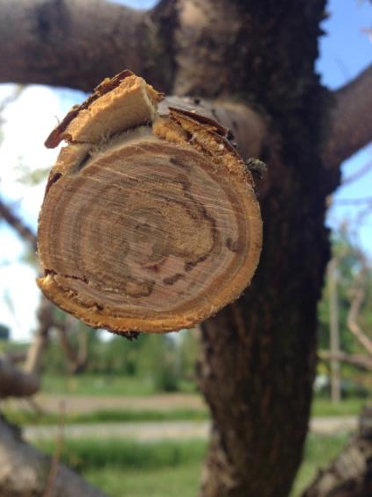
Deterioration of inner wood layers
Wood rotting fungi are usually indication that heartwood is infected

Slide 24
Peach tree decline due to Leucostoma (Cytospora) canker
Loss of scaffolds due to Leucostoma canker

Slide 25
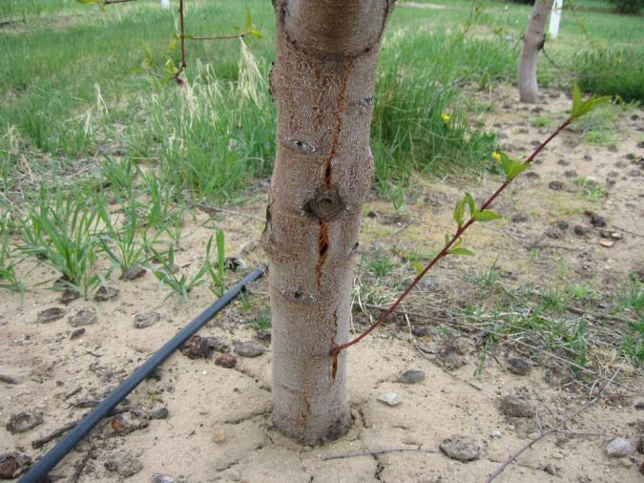
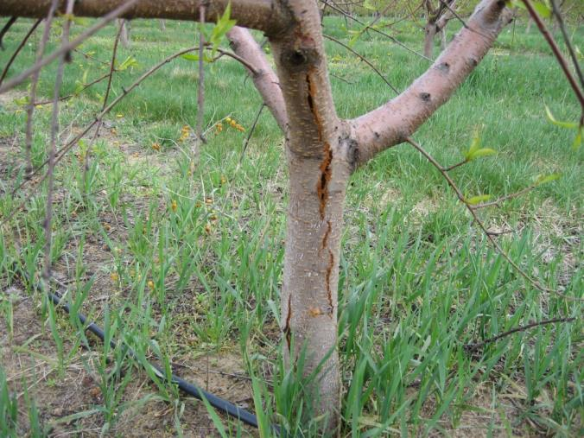
Rapid temperature drop in mid winter 2005 associated with later trunk splitting

Slide 26
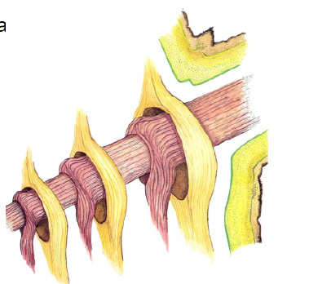
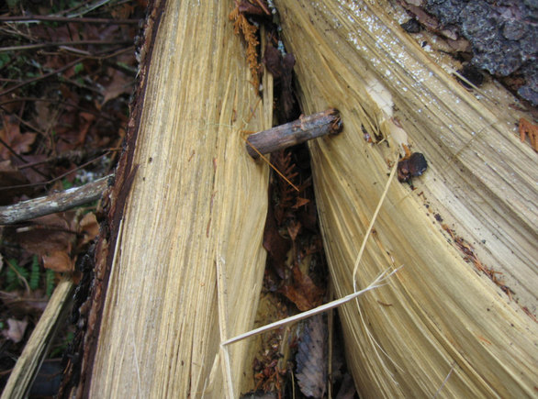
USDA drawing
Annual layers of branch collar around growing side limb protect trunk from fungal pathogens

Slide 27
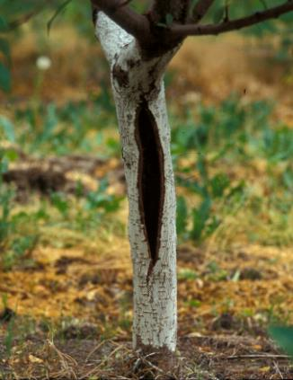
Trees with dying / dead trunk cambium prone to splitting when growth resumes in spring.
Can use small nails to close opening if detected within a few days.

Slide 28
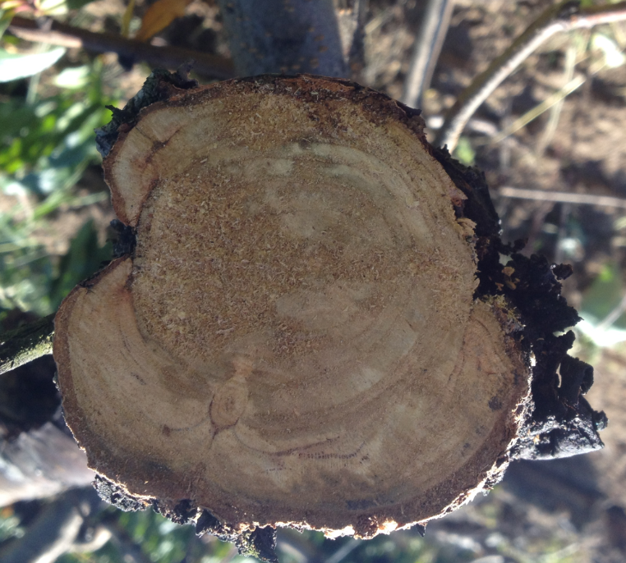
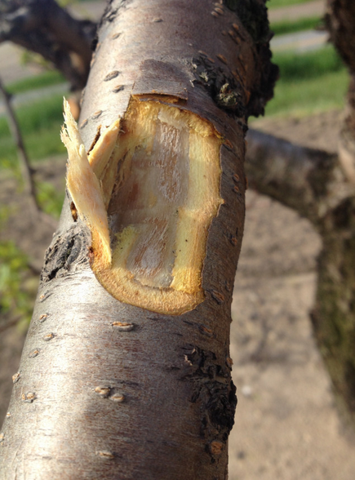
Decline of peach trees following 2013/2014 associated with regional cold spots and health of tree (usually age of tree) going into winter

Slide 29
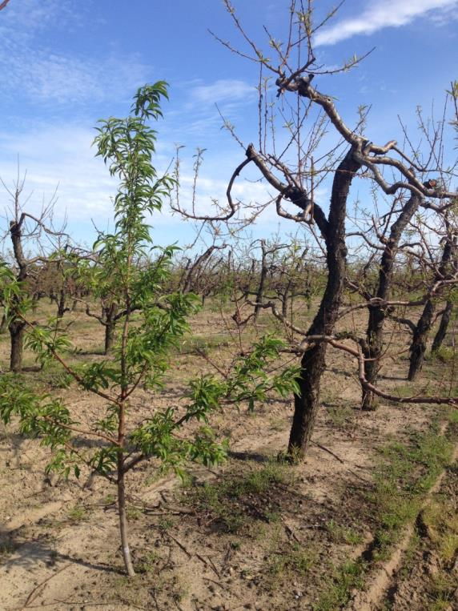
Replant trees doing well, 20 year old trees uniformly declining or dead following winter 2013/2014, low temperature ~ -18 F.

Slide 30
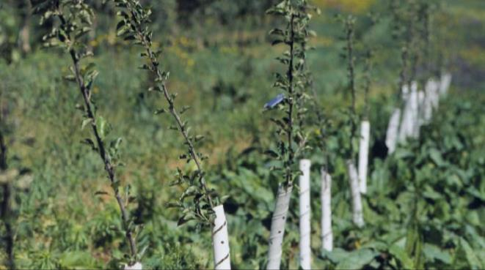
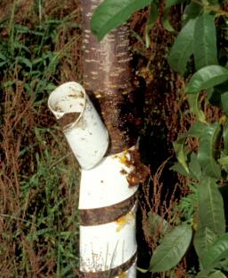
Tree wraps
White wraps reduce damage due to rodents and from rapid temperature fluctuations in trunks due to sunlight in mid winter.
Remove tree wraps in summer to avoid disease & insect problems.
Borer damage under wrap

Slide 31
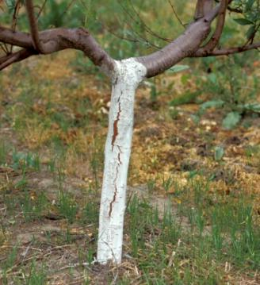
Tree paint
White latex paint reduce damage due to rapid temperature fluctuations in trunks due to sunlight in mid winter.
White latex paint provides some protection against damage by contact herbicides like gramoxone

Slide 32
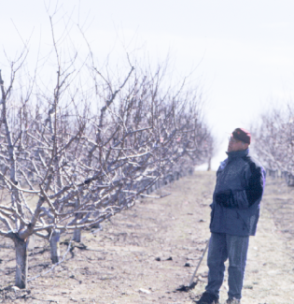
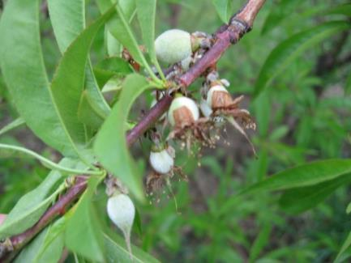
Effect of time of pruning on peach growth and canker problems
Late dormant to green tip
Pre pink to bloom
Pruning time
Post bloom
Vigor response ++++ ++ +
Cut healing + +++ ++
Pathogen active +++ ++ +
Best time for pruning

Slide 33
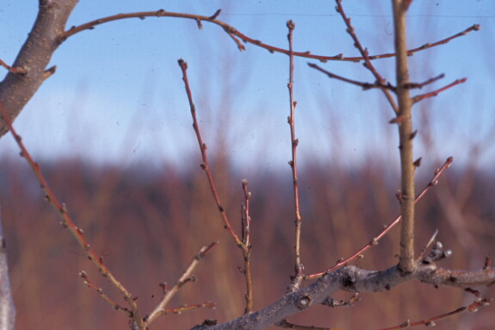
Monitor growth of tree: If average annual growth is less than 1.5 feet then tree is prone to canker and winter damage. If growth is greater than approximately 2.5 feet then tree is prone to fall cold damage

Slide 34
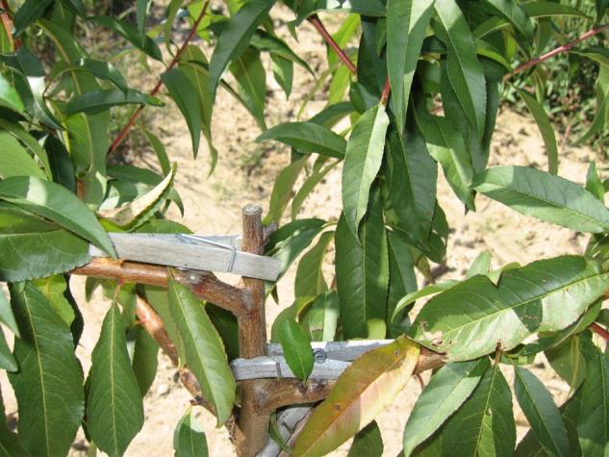
Tree training and winter damage
Limb structure
Crotch angles

Slide 35
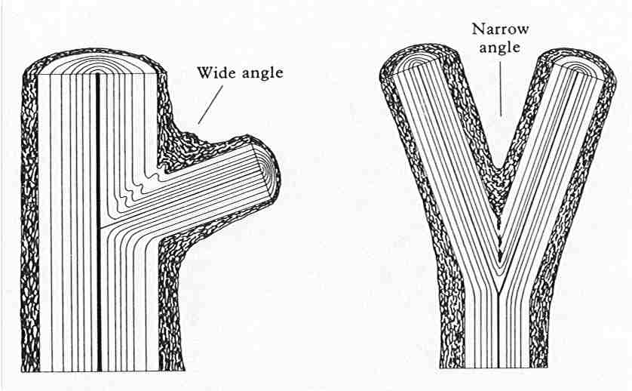
Train for wide crotch angle limbs
Bark inclusions in narrow angle crotches weaken limb

Slide 36
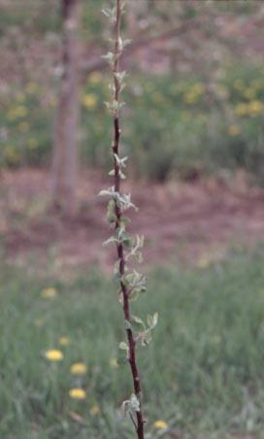
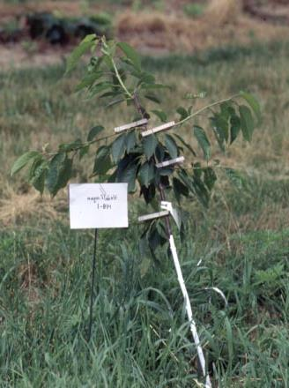
Clothespins to insure wide crotch angles from new growth
Use clothes pins to flatten growth
Remove clothes pins about 2 to 3 weeks later once growth has ‘locked’ into place

Slide 37
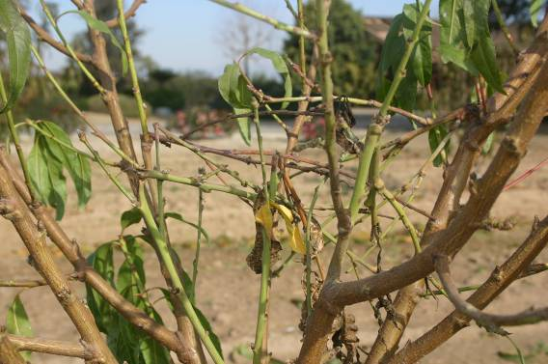
Benign neglect training as a way to avoid big cuts on scaffolds
Pinching, breaking limbs on inside of tree to direct growth outward & avoiding big cuts

Slide 38
Breaking extra limbs into center to force growth outwards
Credit: Kevin Day, Univ. of Calif.

Slide 39
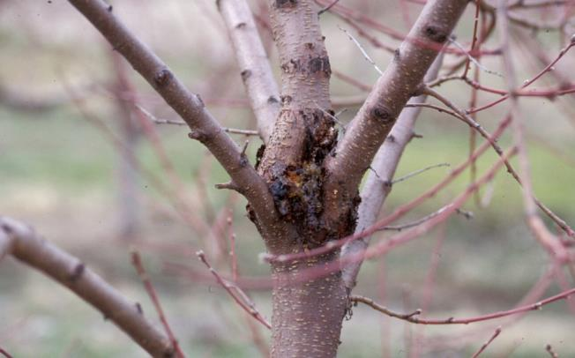
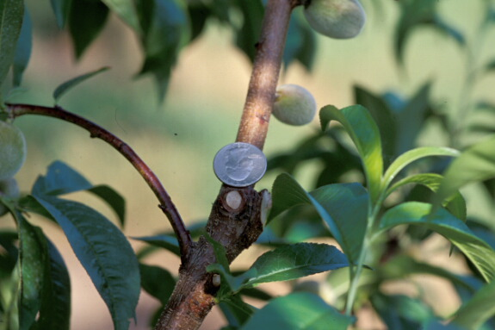
Canker associated with upright crotch angles
Large cuts lead to canker problems

Slide 40
Problems arise when scaffold ends are not pruned

Slide 41
Strong limb growth following scaffold end heading cut
Cuts to remove large limbs will leave big, slow healing wounds

Slide 42
Single & debud technique for avoiding problems at end of scaffolds
Remove all but one or two buds at tip by clearing out buds 3 – 4” below end of branch

Slide 43
Results of singling and debud

Slide 44
Tree with single and debud method has straight scaffolds
Traditional scaffold end cuts results in “dogleg” appearance to scaffolds

Slide 45
Managing Cold Damaged Fruit Trees
What to do following a harsh winter?
Prune at bud swell to pink (normal time)
Prune with normal intensity, strong pruning not advised while trees are recovering from cold damage.
Consider nitrogen program closely…split applications in order to tailor the program according to rainfall and crop situation
Adopt practices that minimize big cuts on the lower part of the scaffolds.

Slide 46
Questions?
Bill Shane, SW Mich Res & Ext Center, Benter Harbor, Michigan 49022, 269-208-1652 cell, email: shane@msu.edu

